Slide 1

Dr. Sajid Iqbal
Department of Computer Science
Bahauddin Zakariya University, Multan

Slide 2

INTRODUCTION TO Machine Learning 3rd Edition
ETHEM ALPAYDIN
© The MIT Press, 2014
alpaydin@boun.edu.tr
http://www.cmpe.boun.edu.tr/~ethem/i2ml3e

Slide 3
Parametric Methods
Chapter Four

Slide 4
4.1 Introduction

Slide 5
Introduction
Statistic: Any value that is calculated from a given sample.
Statistical model uses information provided by sample to make decision
Parametric methods assume that sample is drawn from some known distribution
In parametric approach, the model is defined with the help of small number of parameters i.e. mean, variance
Sample based parameter estimation leads to knowledge of whole distribution
Parametric Modeling
Estimate the parameters from given sample
Plug them in assumed model to get estimated distribution
Use this distribution to make decision
Two methods, we study, for parameter estimation are
Maximum likelihood estimation
Bayesian Estimation
Sample Data
Parameter Estimation
Fitted Model

Slide 6
4.2 Maximum Likelihood Estimation

Slide 7


Maximum Likelihood Estimation - MLE
Let we have iid distributed samples $X={\left\{x^{t}\right\}}_{t=1}^{N}$
Assume $x_{i}^{t}$ are instances drawn from some known distribution
$x_{i}^{t}\sim p(x|θ)$ where $θ$ is parameter
We want to estimate $θ$ that makes samples coming from assumed distribution as likely as possible
For iid samples the joint probability becomes the product of individual probabilities $F_{X,Y}\left(x,y\right)=F_{X}\left(x\right)F_{Y}(y)$
The likelihood of parameter θ given sample X is the product of the likelihoods of the individual points:
$$\begin{aligned}l\left(θ | X\right)=P\left(X | θ\right)=\prod_{t=1}^{N}{p(x^{t}|θ)}\#\end{aligned}$$

Slide 8
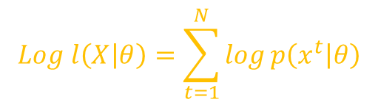

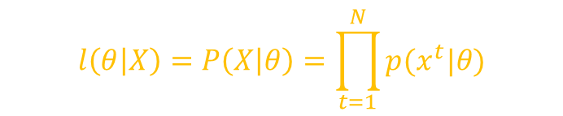
ML Estimation
We want to estimate $θ$ such that X is most likely to be drawn from assumed distribution i.e. $l\left(θ | X\right)$
Search $θ$ that maximizes the likelihood
Multiplication process is compute intensive, take log of both sides to minimize this cost called log likelihood.
How to assume a distribution
Bernoulli: this distribution is used for two class problem
Multinomial: When there are more than two classes
$$\begin{aligned}l\left(θ | X\right)=P\left(X | θ\right)=\prod_{t=1}^{N}{p(x^{t}|θ)}\#\end{aligned}$$
$$\begin{aligned}Log l\left(X | θ\right)=\sum_{t=1}^{N}{log}p\left(x^{t} | θ\right)\#\end{aligned}$$

Slide 9

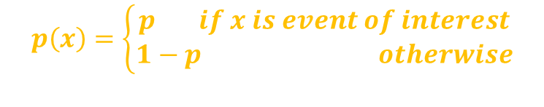
Bernoulli Density
An event occurs with probability p and its not-occurring has probability 1-p.
$P\left(X=x\right)=p^{x}.{\left(1−p\right)}^{1−x}$
$i.e$. for coin experiment
$P\left(X=head\right)=p^{head}{\left(1−p\right)}^{tail}$
Parameter Estimation
P is only parameter to be estimated
$$\begin{aligned}p\left(x\right)=\left\{\begin{aligned}p if x is event of interest \\ 1−p otherwise\end{aligned}\right.\#\end{aligned}$$
$$\begin{aligned}P\left(X=x\right)=p^{x}.{\left(1−p\right)}^{1−x}\#\end{aligned}$$
$$\begin{aligned} E\left[X\right]=\sum_{x}{xp\left(x\right)=1.p+0.\left(1−p\right)=p} \#\end{aligned}$$
$$\begin{aligned}Var\left(X\right)=\sum_{x}{{\left(x−E\left[X\right]\right)}^{2}p\left(x\right)=p\left(1−p\right)}\#\end{aligned}$$

Slide 10



Bernoulli Distribution
$$\begin{aligned}P\left(X=x\right)=p^{x}.{\left(1−p\right)}^{1−x}\#\#\#\#\end{aligned}$$
$$\begin{aligned}\begin{aligned}P\left(X_{1}=x_{1},X_{2}=x_{2},…, X_{N}=x_{N}\right)=\prod_{t=1}^{N}{p^{x^{t}}.{\left(1−p\right)}^{{(1−x)}^{t}}}\#\#\#\end{aligned}\#\end{aligned}$$
$$\begin{aligned}\begin{aligned}L\left(θ | X\right)=L\left(p | X\right)=log⁡[P\left(X=x\right)]=log⁡[\prod_{t=1}^{N}{p^{x^{t}}.{\left(1−p\right)}^{{(1−x)}^{t}}}]\#\end{aligned}\#\end{aligned}$$
$$\begin{aligned}\begin{aligned}L\left(θ | X\right)=\sum_{t=1}^{N}{log⁡[p^{x^{t}}{\left(1−p\right)}^{{(1−x)}^{t}}]}\#\end{aligned}\#\end{aligned}$$
$$\begin{aligned}\begin{aligned}L\left(θ | X\right)=\sum_{t=1}^{N}{x^{t}\log\left[p\right]+\sum_{t=1}^{N}{(1−{x)}^{t}}log(1−p)]}\#\end{aligned}\#\end{aligned}$$
$$\begin{aligned}\begin{aligned}L\left(θ | X\right)=Nx^{t}\log\left[p\right]+\left(N−{Nx}^{t}\right)log(1−p)] \end{aligned}\#\end{aligned}$$

Slide 11
Bernoulli Distribution
$$\begin{aligned}\begin{aligned}L\left(θ | X\right)=Nx^{t}\log\left[p\right]+\left(N−{Nx}^{t}\right)log(1−p) \end{aligned}\#\end{aligned}$$
Estimate of parameter p that maximizes the log likelihood can be found by solving for $\frac{dL}{dp} = 0$
$$\begin{aligned}\begin{aligned}\frac{d}{dp}L\left(θ | X\right)=\frac{d}{dp}[Nx^{t}\log\left[p\right]+\left(N−{Nx}^{t}\right)log(1−p)] \#\end{aligned}\#\end{aligned}$$
$$\begin{aligned}\begin{aligned}\frac{d}{dp}L\left(θ | X\right)=\frac{d}{dp}[Nx^{t}\log{(p)]}+\frac{d}{dp}[\left(N−{Nx}^{t}\right)log(1−p)] \#\end{aligned}\#\end{aligned}$$
$$\begin{aligned}\begin{aligned}\frac{d}{dp}L\left(θ | X\right)=Nx^{t}\frac{d}{dp}[\log{(p)]}+\left(N−{Nx}^{t}\right)\frac{d}{dp}[log(1−p)] \end{aligned}\#\end{aligned}$$
$$\begin{aligned}\begin{aligned}\frac{d}{dp}L\left(θ | X\right)=Nx^{t} \left(\frac{1}{p}\right)\frac{dp}{dp}+\left(N−{Nx}^{t}\right)(\frac{1}{1−p})\frac{d(−p)}{dp}] \#\end{aligned}\#\end{aligned}$$

Slide 12

Bernoulli Distribution
$$\begin{aligned}\begin{aligned}\frac{d}{dp}L\left(θ | X\right)=Nx^{t} \left(\frac{1}{p}\right)\frac{dp}{dp}+\left(N−{Nx}^{t}\right)(\frac{1}{1−p})\frac{d(−p)}{dp}] \#\end{aligned}\#\end{aligned}$$
$$\begin{aligned}\frac{d}{dp}L\left(θ | X\right)=Nx^{t} \left(\frac{1}{p}\right)−\left(N−{Nx}^{t}\right)(\frac{1}{1−p})\end{aligned}$$
$$\begin{aligned}\begin{aligned}\frac{d}{dp}L\left(θ | X\right)=\left(1−p\right)Nx^{t} −p\left(N−{Nx}^{t}\right)=0\#\end{aligned}\end{aligned}$$
$$\begin{aligned}\begin{aligned}\frac{d}{dp}L\left(θ | X\right)=Nx^{t}−pNx^{t} −pN+pNx^{t}=0\#\end{aligned}\end{aligned}$$
$$\begin{aligned}\begin{aligned}\frac{d}{dp}L\left(θ | X\right)=Nx^{t} −pN=0\#\end{aligned}\#\end{aligned}$$
$$\begin{aligned}Nx^{t} =pN\#\#\end{aligned}$$
$$\begin{aligned}est(p)=\frac{Nx^{t}}{N}=\frac{\sum_{t=1}^{N}{x^{t}}}{N}\#\#\end{aligned}$$
$$\begin{aligned}\begin{aligned}\frac{Nx^{t}}{N} =p\#\end{aligned}\#\end{aligned}$$

Slide 13
Bernoulli Distribution
$$\begin{aligned}est(p)=\frac{\sum_{t=1}^{N}{x^{t}}}{N}\#\#\end{aligned}$$
We observed that there is only one parameters in Ber. Dist.
It means that if we could only estimate p, we can estimate the distribution of given sample data

Slide 14

Multinomial Density
It is generalization of Bernoulli distribution with k-classes
Let $X={\left\{x^{t}\right\}}_{t=1}^{N}$ and
For N such experiments
Here (1-p)=0 so
$$\begin{aligned}p\left(x\right)=\left\{\begin{aligned}1 if experiment outputs state i \\ 0 otherwise \end{aligned}\right.\#\end{aligned}$$
$$\begin{aligned}P\left(X_{1}=x_{1},X_{2}=x_{2},…, X_{N}=x_{N}\right)=\prod_{t=1}^{N}{p^{x^{t}}.{\left(1−p\right)}^{{(1−x)}^{t}}}\#\end{aligned}$$
$$\begin{aligned}P\left(X_{1}=x_{1},X_{2}=x_{2},…, X_{N}=x_{N}\right)=\prod_{t=1}^{N}{p_{t}^{x^{t}}}\#\#\end{aligned}$$
$$\begin{aligned}log⁡(P\left(X\right)=log⁡(\prod_{t=1}^{N}{p_{t}^{x^{t}})}\#\#\end{aligned}$$
$$\begin{aligned}log⁡(P\left(X\right)=\sum_{t=1}^{N}{\log\left(p_{t}^{x^{t}}\right)}\#\#\end{aligned}$$

Slide 15


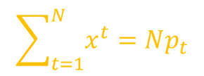
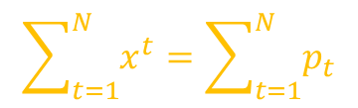
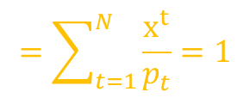
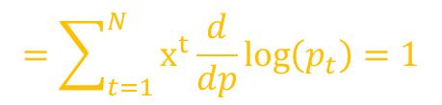
$$\begin{aligned}log⁡(P\left(X\right)=\sum_{t=1}^{N}{\log\left(p_{t}^{x^{t}}\right)=\sum_{t=1}^{N}{x^{t}\log\left(p_{t}\right)}}\#\#\end{aligned}$$
For MLE, we take derivative of both sides
$$MLE=\frac{d}{dp}(\log\left(P\left(X\right)\right)=\frac{d}{dp}\sum_{t=1}^{N}{x^{t}\log\left(p_{t}\right)}=1$$
$$\sum_{t=1}^{N}{x^{t}}=Np_{t}$$
$$=\sum_{t=1}^{N}{x^{t}\frac{d}{dp}\log\left(p_{t}\right)}=1$$
$$\begin{aligned}MLE p_{t}=\frac{\sum_{1}^{N}{x^{t}}}{N}\#\end{aligned}$$
$$=\sum_{t=1}^{N}{\frac{x^{t}}{p_{t}}}=1$$
$$\sum_{t=1}^{N}{x^{t}}=\sum_{t=1}^{N}{p_{t}}$$

Slide 16




Estimating the Gaussian Distribution
Gaussian Distribution has parameters $E\left[X\right]=μ$ and $Var\left(X\right)=σ^{2}$
Its density is given by
If $x\sim N(μ,σ^{2})$ the log likelihood is given by
$\begin{aligned} p\left(x\right)=\frac{1}{\sqrt{2π}σ}e^{−\frac{{\left(x−μ\right)}^{2}}{2σ^{2}}} −∞≤x≤∞\end{aligned}$
$$\begin{aligned}L\left(θ | X\right)=\sum_{t=1}^{N}{log}p\left(x^{t} | θ\right)\#=\sum_{t=1}^{N}{log} [\frac{1}{\sqrt{2π}σ}e^{−\frac{{\left(x−μ\right)}^{2}}{2σ^{2}}}]\end{aligned}$$
$$\begin{aligned}L\left(θ | X\right)=\sum_{t=1}^{N}{log} \left[\frac{1}{\sqrt{2π}σ}\right]+\sum_{t=1}^{N}{log}e^{−\frac{{\left(x−μ\right)}^{2}}{2σ^{2}}} \end{aligned}$$
$$=\sum_{t=1}^{N}{log}{\left[\sqrt{2π} σ\right]}^{−1}+\sum{−}[\frac{{\left(x−μ\right)}^{2}}{2σ^{2}}]$$

Slide 17

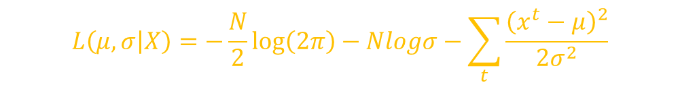




$$=\sum_{t=1}^{N}{log}{\left[\sqrt{2π} σ\right]}^{−1}+\sum{−}[\frac{{\left(x−μ\right)}^{2}}{2σ^{2}}]$$
$$=−\sum_{t=1}^{N}{[log}{\left[2π\right]}^{\frac{1}{2}}+logσ]+\sum{−}[\frac{{\left(x−μ\right)}^{2}}{2σ^{2}}]$$
$$L\left(μ,σ | X\right)=−\frac{N}{2}\log\left(2π\right)−Nlogσ−\sum_{t}{\frac{{\left(x^{t}−μ\right)}^{2}}{2σ^{2}}}$$
$$=−\sum_{t=1}^{N}{[\frac{1}{2}log}\left[2π\right]+logσ]+\sum{−}[\frac{{\left(x−μ\right)}^{2}}{2σ^{2}}]$$
$$=−\frac{N}{2}log\left[2π\right]+Nlogσ−\sum{[\frac{{\left(x−μ\right)}^{2}}{2σ^{2}}]}$$
$$=\begin{aligned}−\frac{N}{2}\log\left(2π\right)−Nlogσ−\sum_{t}{\frac{{\left(x^{t}−μ\right)}^{2}}{2σ^{2}}} \\ \#\end{aligned}$$

Slide 18

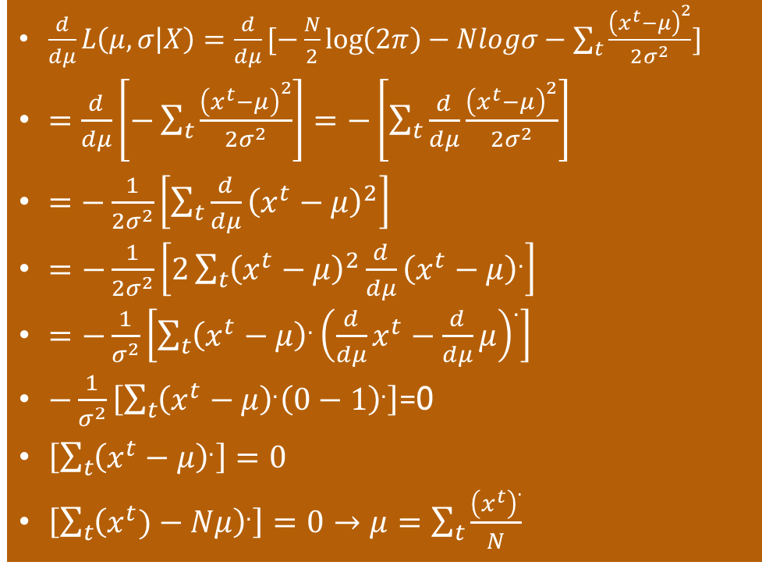
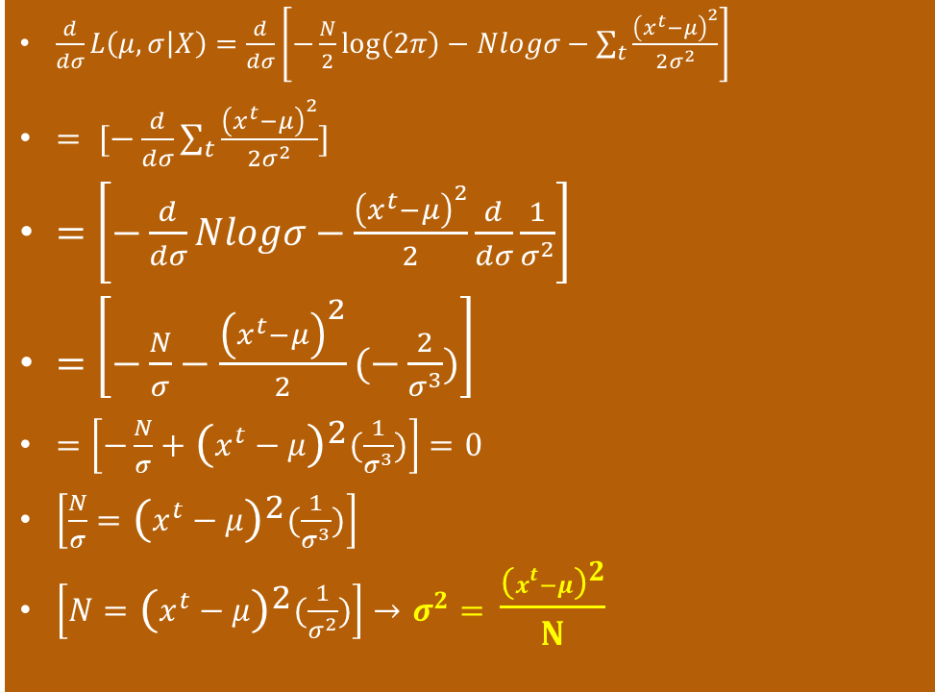
$$L\left(μ,σ | X\right)=−\frac{N}{2}\log\left(2π\right)−Nlogσ−\sum_{t}{\frac{{\left(x^{t}−μ\right)}^{2}}{2σ^{2}}}$$
We take the partial derivatives w.r.t. to $μ$ and $σ$
$\frac{d}{dμ}L\left(μ,σ | X\right)=\frac{d}{dμ}[−\frac{N}{2}\log\left(2π\right)−Nlogσ−\sum_{t}{\frac{{\left(x^{t}−μ\right)}^{2}}{2σ^{2}}}]$
$=\frac{d}{dμ}\left[−\sum_{t}{\frac{{\left(x^{t}−μ\right)}^{2}}{2σ^{2}}}\right]=−\left[\sum_{t}{\frac{d}{dμ}\frac{{\left(x^{t}−μ\right)}^{2}}{2σ^{2}}}\right]$
$=−\frac{1}{2σ^{2}}\left[\sum_{t}{\frac{d}{dμ}{\left(x^{t}−μ\right)}^{2}}\right]$
$=$ $−\frac{1}{2σ^{2}}\left[2\sum_{t}{{\left(x^{t}−μ\right)}^{2}\frac{d}{dμ}{\left(x^{t}−μ\right)}^{.}}\right]$
$=$ $−\frac{1}{σ^{2}}\left[\sum_{t}{{\left(x^{t}−μ\right)}^{.}{\left(\frac{d}{dμ}x^{t}−\frac{d}{dμ}μ\right)}^{.}}\right]$
$−\frac{1}{σ^{2}}\left[\sum_{t}{{\left(x^{t}−μ\right)}^{.}{\left(0−1\right)}^{.}}\right]$=0
$\left[\sum_{t}{{\left(x^{t}−μ\right)}^{.}}\right]=0$
$\left[\sum_{t}{{\left(x^{t})−Nμ\right)}^{.}}\right]=0→μ=\sum_{t}{\frac{{\left(x^{t}\right)}^{.}}{N}}$
$\frac{d}{dσ}L\left(μ,σ | X\right)=\frac{d}{dσ}\left[−\frac{N}{2}\log\left(2π\right)−Nlogσ−\sum_{t}{\frac{{\left(x^{t}−μ\right)}^{2}}{2σ^{2}}}\right]$
$= [−\frac{d}{dσ}\sum_{t}{\frac{{\left(x^{t}−μ\right)}^{2}}{2σ^{2}}}]$
$=\left[−\frac{d}{dσ}Nlogσ−\frac{{\left(x^{t}−μ\right)}^{2}}{2}\frac{d}{dσ}\frac{1}{σ^{2}}\right]$
$=\left[−\frac{N}{σ}−\frac{{\left(x^{t}−μ\right)}^{2}}{2}(−\frac{2}{σ^{3}})\right]$
$=\left[−\frac{N}{σ}+{\left(x^{t}−μ\right)}^{2}(\frac{1}{σ^{3}})\right]=0$
$\left[\frac{N}{σ}={\left(x^{t}−μ\right)}^{2}(\frac{1}{σ^{3}})\right]$
$\left[N={\left(x^{t}−μ\right)}^{2}(\frac{1}{σ^{2}})\right]→$ $σ^{2}=$ $\frac{{\left(x^{t}−μ\right)}^{2}}{N}$

Slide 19



The MLE for parameters $μ$ and $σ$ by taking the partial derivatives of the log likelihood and setting them equal to 0 are
$$\begin{aligned}μ=\frac{\sum_{t}{x^{t}}}{N}\#\end{aligned}$$
$$\begin{aligned}σ^{2}=\frac{\sum_{t}{{\left(x^{t}−m\right)}^{2} }}{N}\#\end{aligned}$$

Slide 20



Thanks for watching
Dr. Sajid Iqbal
Assistant Professor
Department of Computer Science
Bahauddin Zakariya University, Multan
sajidiqbal.pk@gmail.com
https://github.com/sajjo79/Design_and_Analysis_of_Algorithms
Allah Hafiz
COMEDXD

Slide 21
Assignments

